Slide 1
Fraud detection

Slide 2
Content
Data preprocessing
Exploratory Data Analysis
Detect fraudulent customers
Detect only “type_2” fraudulent customers
Conclusion

Slide 3
Fraud detection Metrics
Scenario 1: High precision, lower recall (stringent fraud control): In this scenario, the organization prioritizes minimizing false positives to ensure that genuine customers are not incorrectly flagged as fraud. The focus is on maintaining a high level of trust and customer satisfaction, even if it means potentially missing some fraudulent cases.
Scenario 2: High recall, moderate precision (comprehensive fraud detection): In this scenario, the organization aims to capture as many instances of fraud as possible, even if it means tolerating a higher rate of false positives. The focus is on maximizing fraud detection to minimize financial losses.
Scenario 3: Balanced precision and recall (optimal trade-off): In some cases, there may be a need to strike a balance between precision and recall.
The ideal precision and recall will depend on the priorities and constraints of the organization.

Slide 4

Data preprocessing

Slide 5
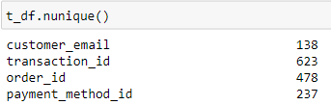
Data preprocessing
Transactions
Customers
Check duplicates;
customer_email object
customer_phone object
customer_device object
customer_ip_address object
customer_billing_address object
transactions_count int64
orders_count int64
payments_count int64
fraud_flag bool
fraud_type object
fraud_score int64
customer_email object
transaction_id object
order_id object
payment_method_id object
payment_method_registration_failure int64
payment_method_type object
payment_method_provider object
transaction_amount int64
transaction_failed int64
order_state object
New features:
customer_ip and state
one-hot encoding and groupby/sum
New Feature: transaction_amount
Transaction_failed
payment_method_registration_failure
Left join transaction on customer_email
groupby/sum
Raw Data frame

Slide 6
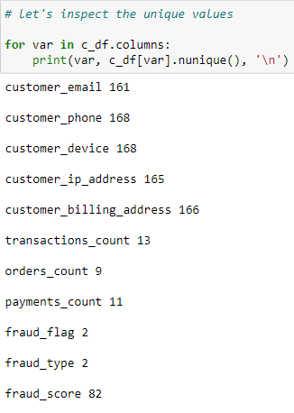
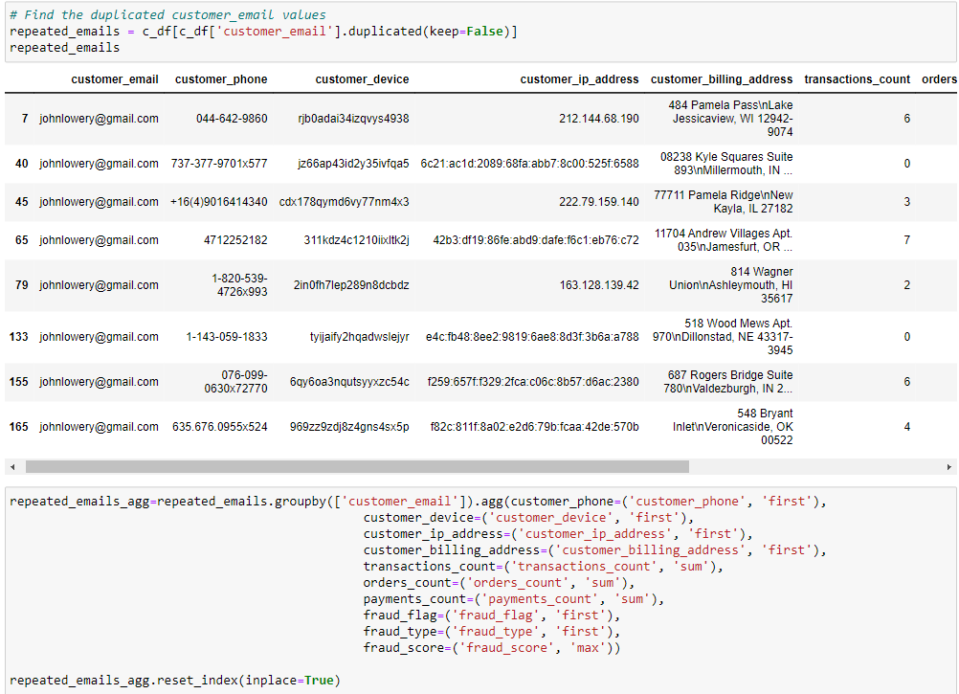
Data preprocessing – Check duplicates
Duplicates are all fraud.
Duplicated customer_email, customer_ip_address, customer_billing_address are high chance to be fraud.

Slide 7
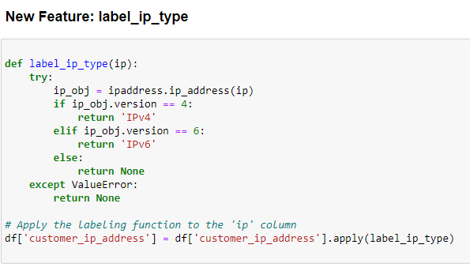
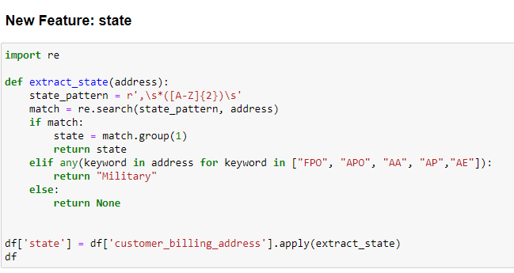
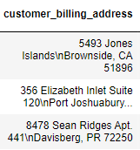
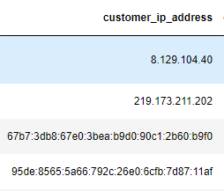
Data preprocessing – customer_ip_address; state

Slide 8
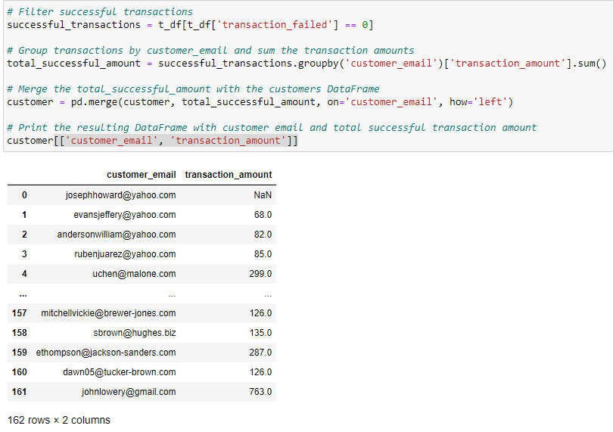
Data preprocessing – transaction_amount
In customers table, calculate total successful transaction amount by each customer.
New Feature: transaction_amount

Slide 9
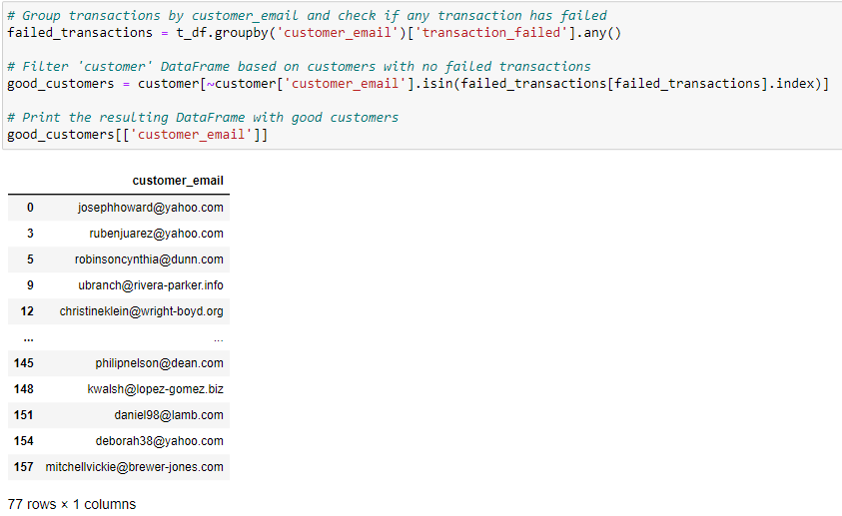
Data preprocessing – good customers
In transactions table, we define “good customers” as customers who never failed any transactions. Return the good customer list.

Slide 10
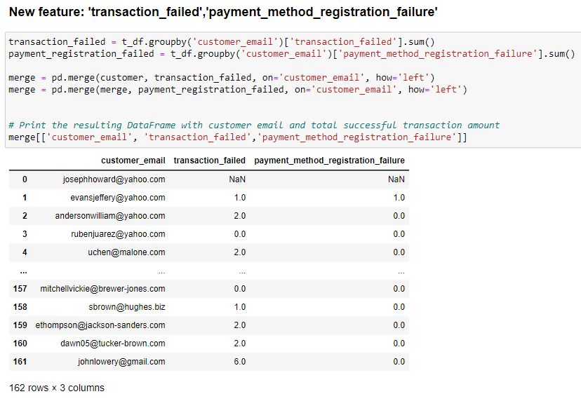
Data preprocessing – payment_method_registration_failure transaction_failed
Transaction table Groupby/sum
Merge with customer table
New Feature: payment_method_registration_failure transaction_failed

Slide 11
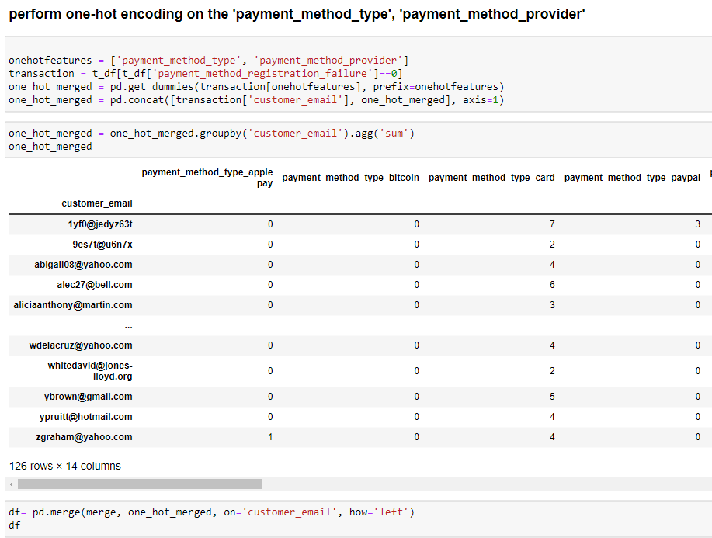
Data preprocessing – payment_method_type payment_method_provider
Transaction table one-hot encoding
Groupby/sum
Merge with customer table

Slide 12
Data preprocessing
Transactions
Customers
Check duplicates;
customer_email object
customer_phone object
customer_device object
customer_ip_address object
customer_billing_address object
transactions_count int64
orders_count int64
payments_count int64
fraud_flag bool
fraud_type object
fraud_score int64
customer_email object
transaction_id object
order_id object
payment_method_id object
payment_method_registration_failure int64
payment_method_type object
payment_method_provider object
transaction_amount int64
transaction_failed int64
order_state object
New features:
customer_ip and state
one-hot encoding and groupby/sum
New Feature: transaction_amount
Transaction_failed
payment_method_registration_failure
Left join transaction on customer_email
groupby/sum
Raw Data frame

Slide 13
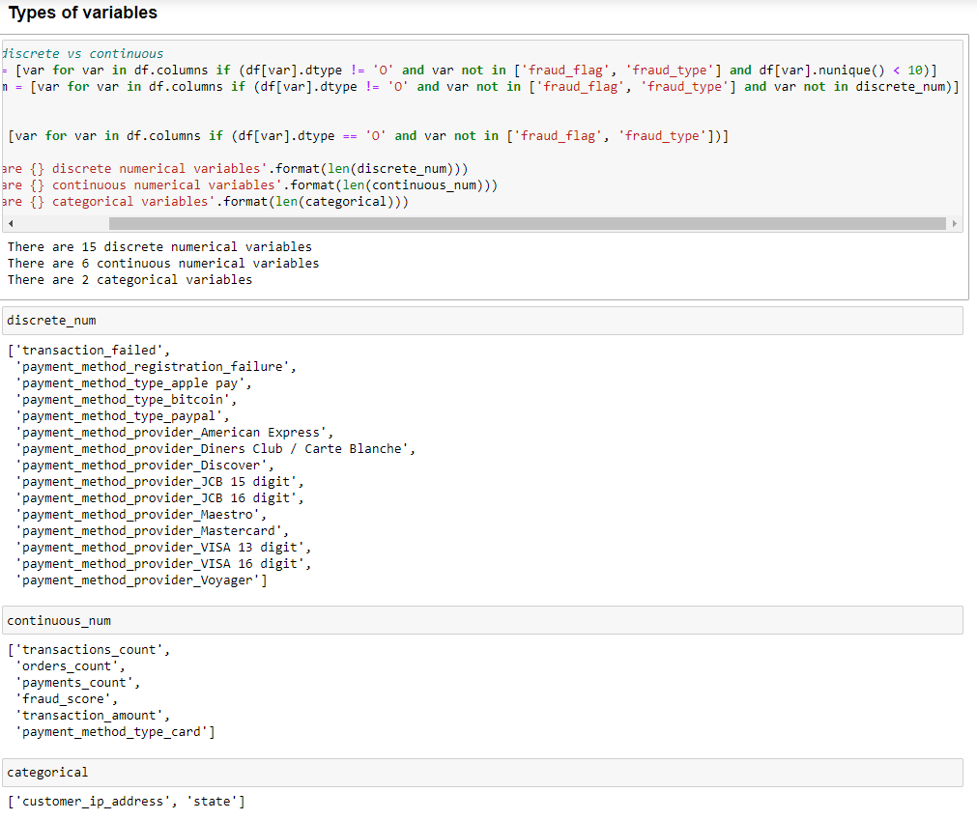
Data preprocessing – Overview

Slide 14
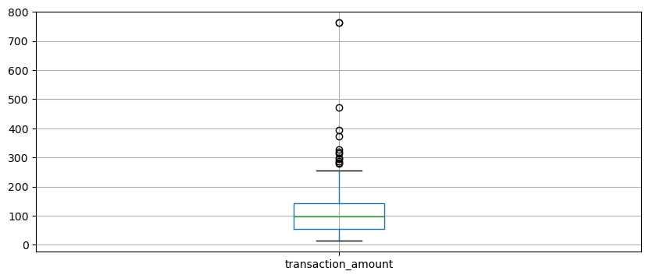
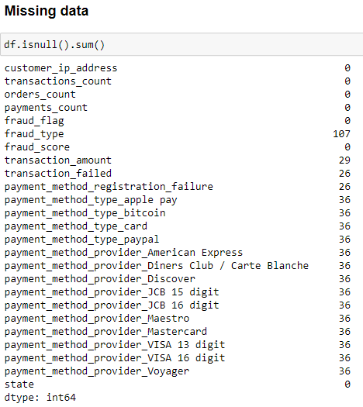
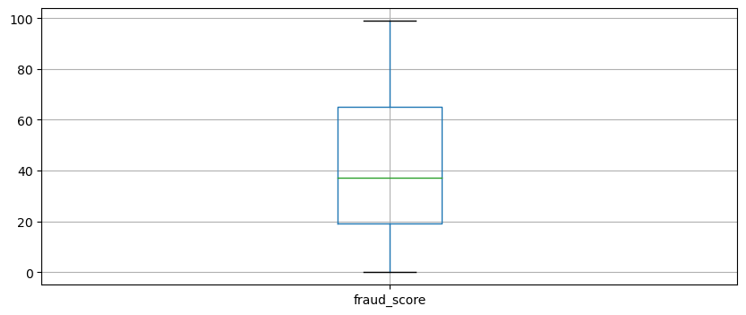
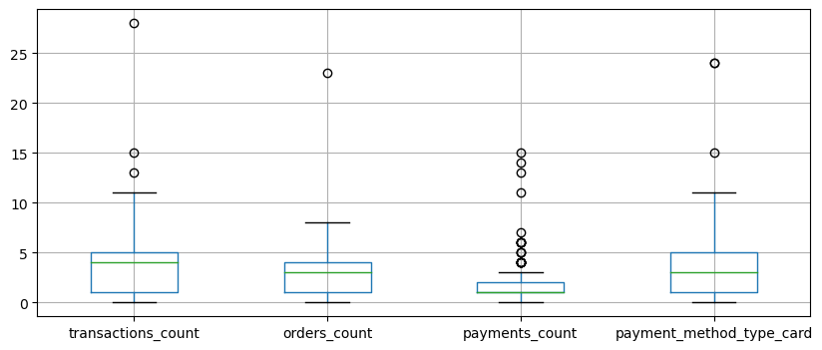
Data preprocessing –Data Quality
Missing data
Outliers
Feature magnitude

Slide 15
Exploratory Data Analysis

Slide 16
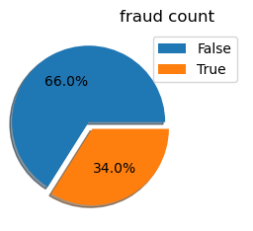
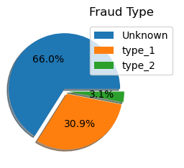
Target
Imbalanced data
When we predict the fraud type, we have very small amount of minority class.
When the majority class heavily outweighs the minority class, as in this case, it can pose challenges for machine learning models to learn and predict the minority class accurately.

Slide 17
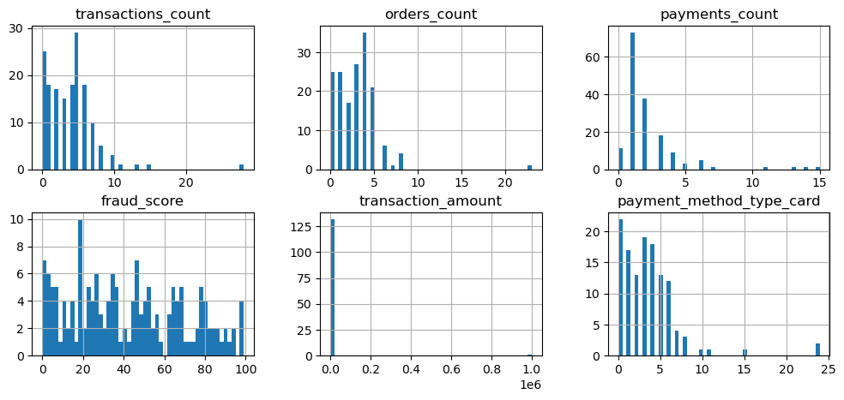
Continuous Numerical Features

Slide 18
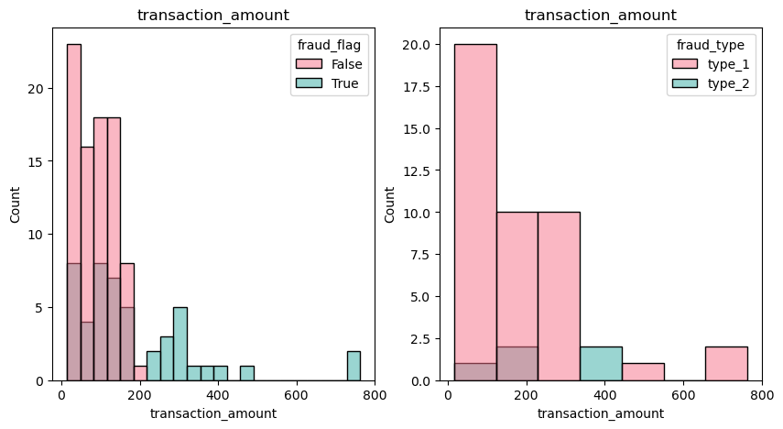
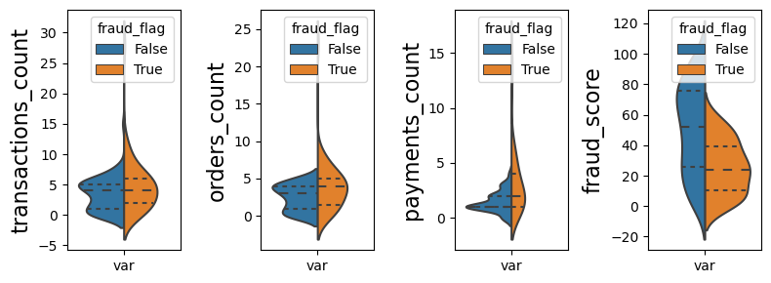
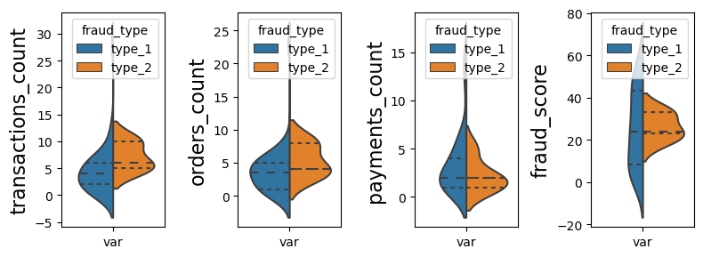
Distribution of continuous numeric features vs Fraud_flag or Fraud_type
Fraudulent customers has a wider range of transaction amount, transaction count, order count

Slide 19
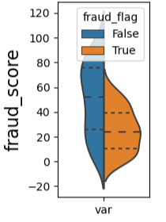
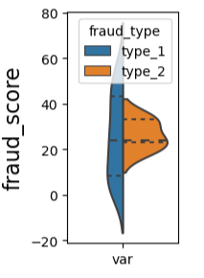
Fraud detection scoring model is not accurate, due to there are different types of fraud.
Using the fraud score to predict fraud is not accurate. This is because there are different types of fraud, higher number doesn’t indicate a higher level of risk and the fraud score alone may not capture all the necessary information to differentiate between them.
For example, in Type 1 fraud cases, the fraud score vary from low to high, indicating a wide range of fraudulent activities. On the other hand, Type 2 fraud cases may have a moderate level of fraud score, which is not be classified as high.

Slide 20
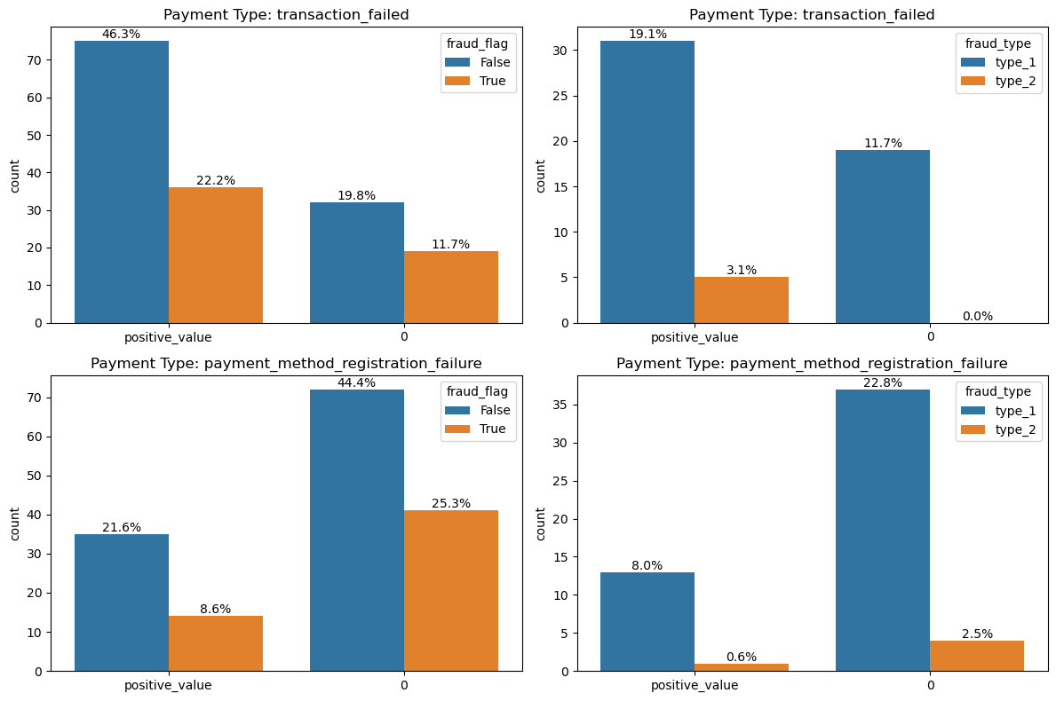
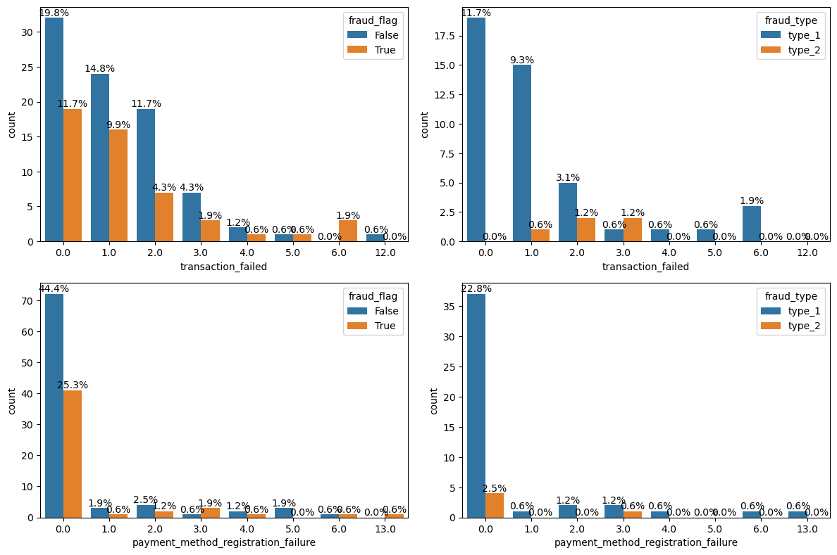
Discrete Variables: transaction_failed payment_method_registration_failure
All Fraud Type 2 has varied numbers of transaction failure, but not necessary payment registration failure.

Slide 21
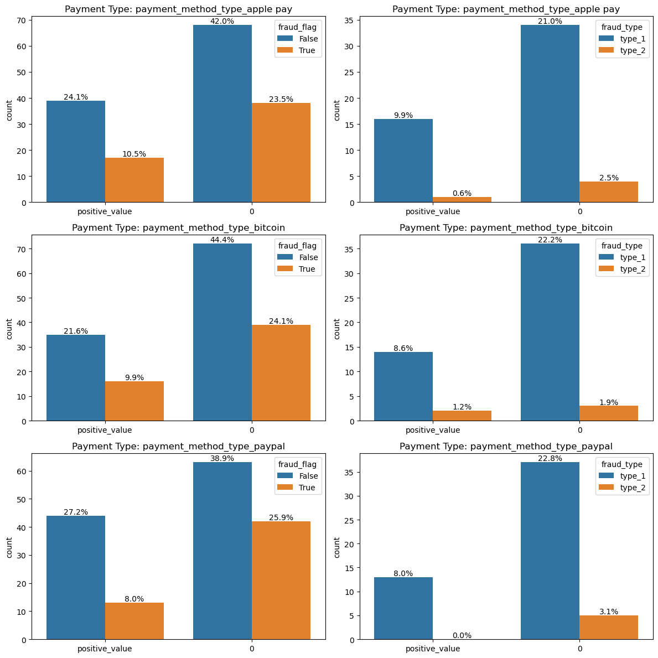
Discrete Variables: payment_method_type
The chance of fraud:
Apple pay > bitcoin > PayPal
The chance of fraud type2
Bitcoin> apple pay> PayPal

Slide 22
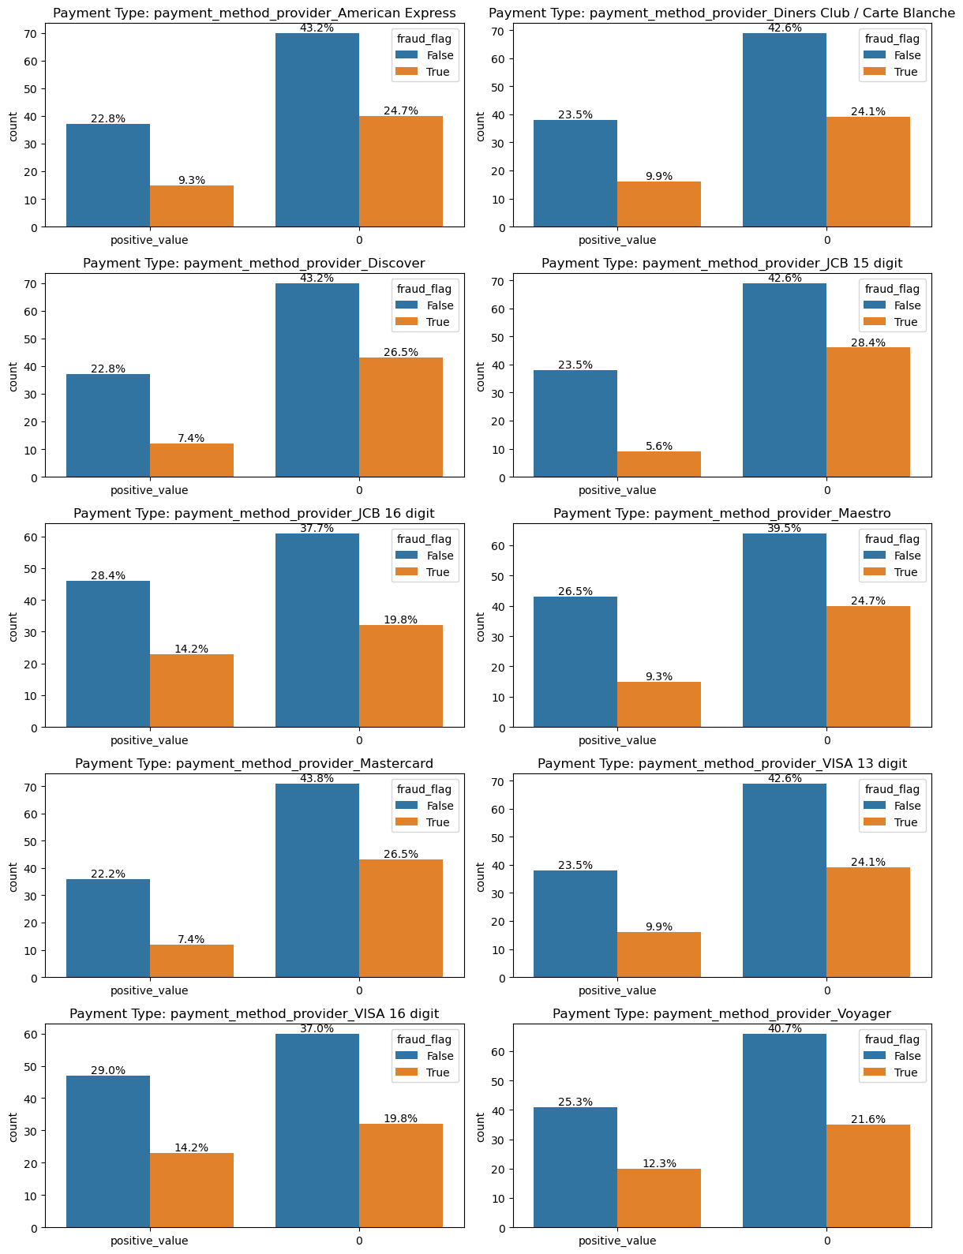
Discrete Variables: payment_method_provider
High chance of fraud:
Visa_16 digit, JCB_16 digit
High chance of fraud type2
Voyager

Slide 23
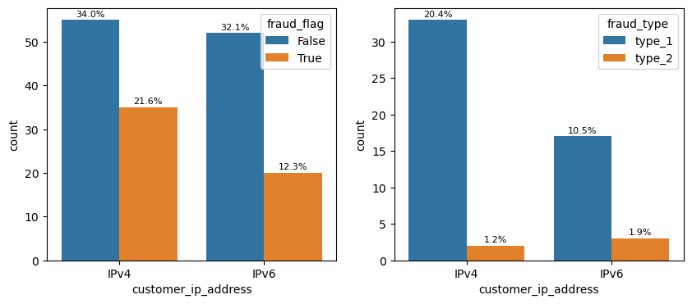
customer_ip_address
More fraud is IPv4
There could be other ways to group customer_ip_address

Slide 24
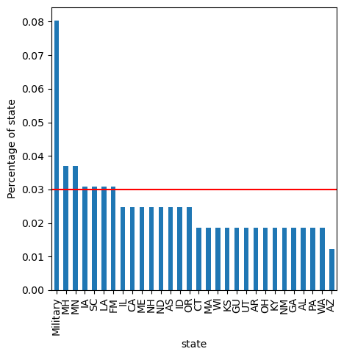
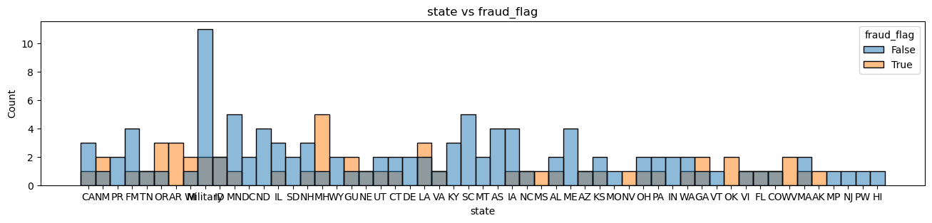
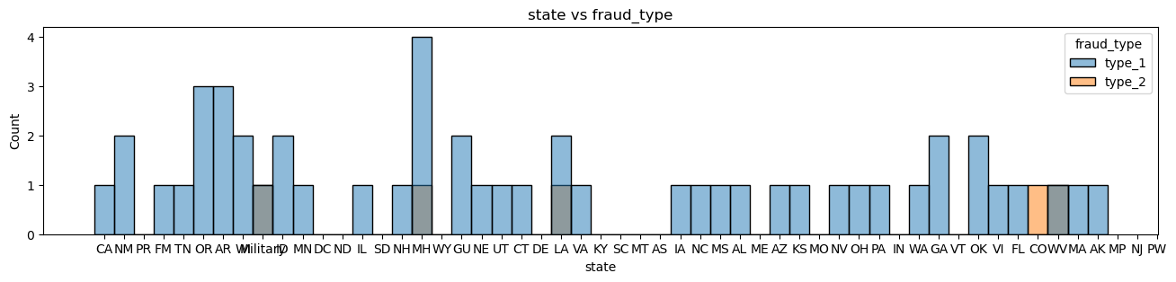
States
High-cardinality categorical feature: overfitting problem, encoders tuning or group the values
PR, DC, ND, SD, WY, DE, KY, SC, MT, AS, ME, MO, IN, VT, MP, NJ, PW, HI are all not fraud
military, MH, LA CO, WV are all type2 fraud.

Slide 25
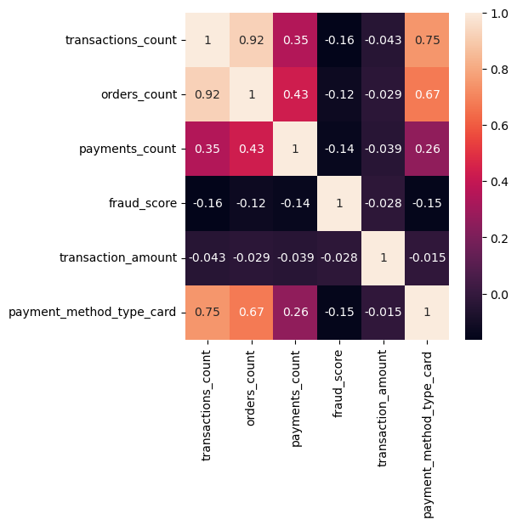
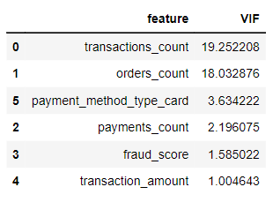
Relationship between variables Correlation between continuous numeric features
payment_method_type_card has linear correlation with transactions_count, orders_count.
transactions_count and orders_count show strong correlation.
Transactions_count show high multicollinearity with other variables.
Orders_count show high multicollinearity with other variables.

Slide 26
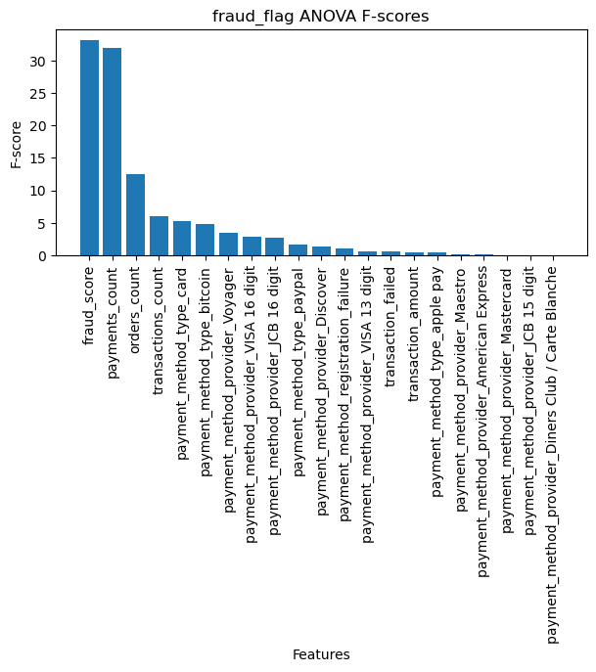
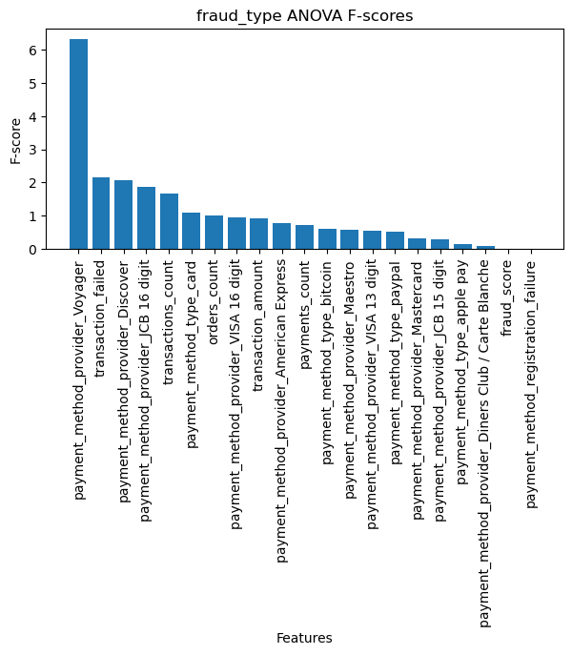
Relationship between target and variables
Fraud_flag has strong association with fraud score, payments_count, orders_count.
Fraud_type has strong association with payment provider voyager, transaction failed.

Slide 27
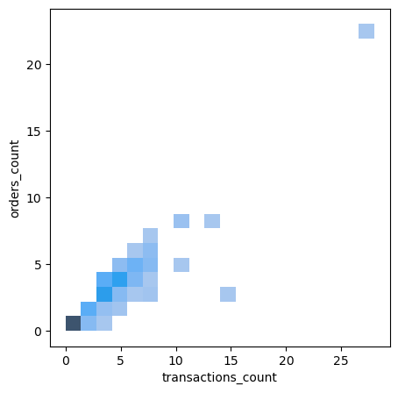
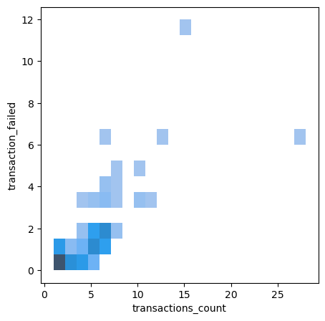
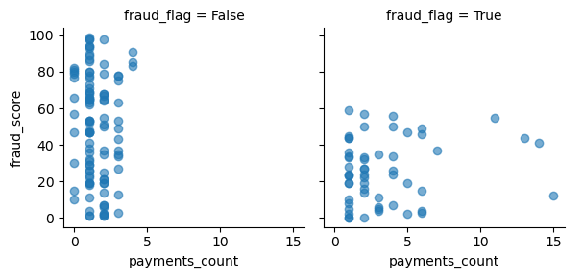
Relationship between variables
transactions_count and orders_count show strong correlation.
Fraud_flag has strong association with fraud score, payments_count
A high fraud score does not necessarily indicate the presence of fraud.

Slide 28
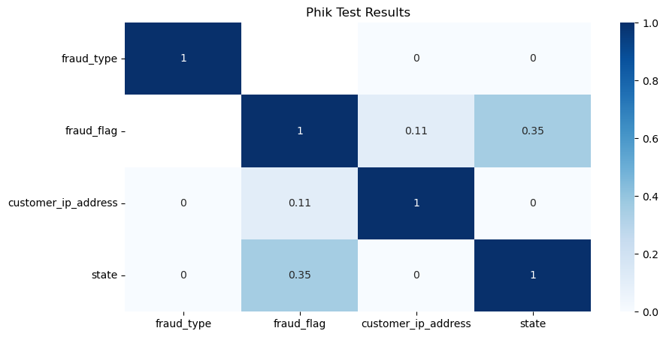
The association between two categorical variables
Fraud_flag has some association with state

Slide 29
EDA
1. Target
- Fraud_flag:66% False, 34% True
- Fraud_type:66% unknown, 30.9% type_1, 3.1% type_2 (imbalanced data)
2. Continuous variables show good variance vs Fraud_flag and Fraud_type. Fraudulent customers has a wider range of transaction amount, transaction count, order count. Type 1 fraud cases, the fraud score vary from low to high, indicating a wide range of fraudulent activities. On the other hand, Type 2 fraud cases may have a moderate level of fraud score, which is not be classified as high.
All Fraud Type 2 has varied numbers of transaction failure, but not necessary payment registration failure.
Customers use PayPal have less chance of fraudulent. Otherwise, Customers use PayPal are all Fraud type 2.
Customers use Visa_16 digit, JCB_16 digit have higher chance of fraudulent. Customers use Voyager have higher chance of type 2 fraudulent.
More fraud is IPv4.
PR, DC, ND, SD, WY, DE, KY, SC, MT, AS, ME, MO, IN, VT, MP, NJ, PW, HI are all not fraud
military, MH, LA CO, WV are all type2 fraud.
3. Linear correlation
- payment_method_type_card has linear correlation with transactions_count, orders_count.
- transactions_count and orders_count show strong linear correlation.
- Transactions_count and Orders_count show high multicollinearity with other variables.
4. Relation between target and variables
- Fraud_flag has strong association with fraud score, payments_count, orders_count.
- Fraud_type has strong association with payment provider voyager.
- Fraud_flag has some association with state

Slide 30
Fraud_flag Model

Slide 31
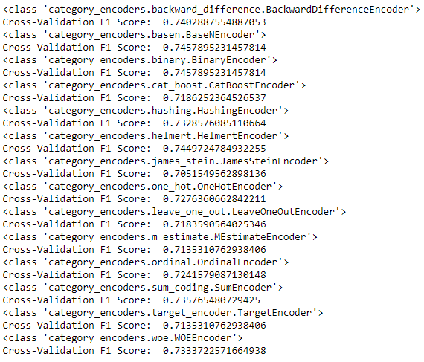
Fraud_flag Model
Data Split
Data was split as train set and test set using ‘train_test_split’ with test_size = 0.2, stratify=y.
Missing value: Use arbitrary value imputation.
Categorical encoders tuning on 'state’:
choose WOEEncoder for now, with high Cross-Validation F1 Score. If there is enough time, need more time to try different encoder. WOEEncoder, are designed to handle categorical variables based on target information, making them suitable for classification problems.

Slide 32
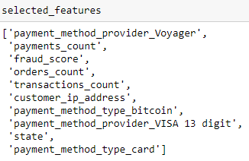
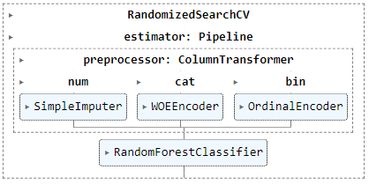
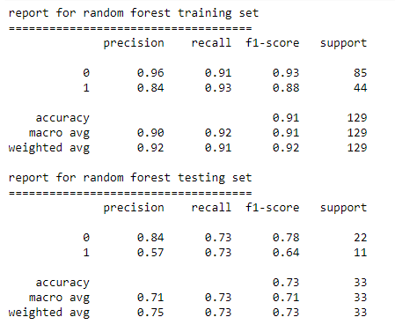

Fraud_flag Model
Feature selection for modeling: Use Random Feature importance and permutation_importance
Modeling: RandomForest and XGBoost. RandomForestClassifier has overfitting problem, try XGBoost with regularization.

Slide 33
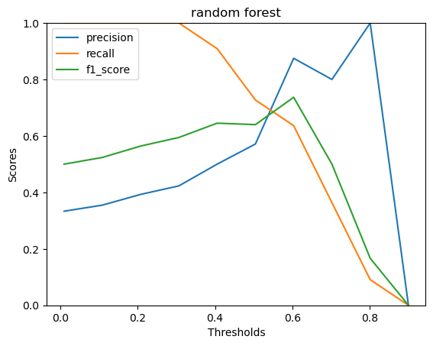
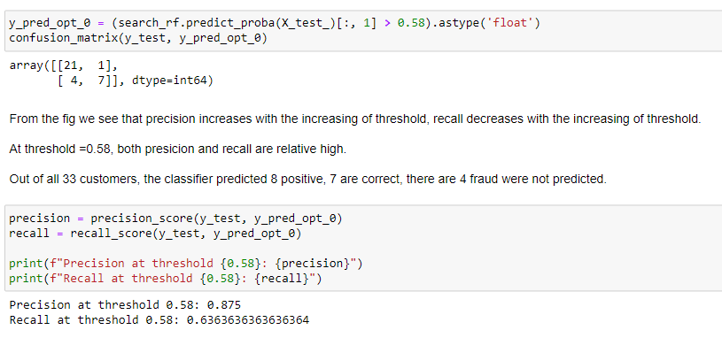
Threshold optimization
The threshold can be changed based on business needs.

Slide 34
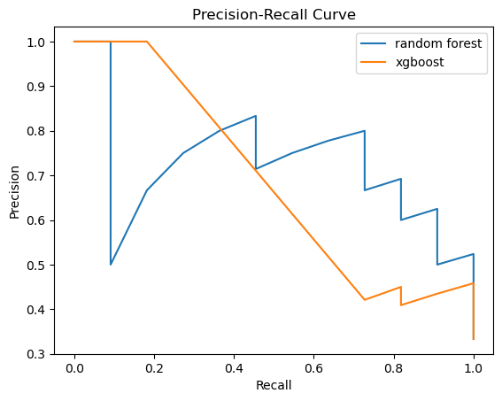
Model Selection
At high precision, random forest has better recall. Therefore, random forest is selected for our final model.
Threshold is optimized for higher precision and recall. At threshold 0.63, precision is 87%, recall is 63%.
random forest AUC-PR: 0.7247405372405372
xgboost: 0.6879253582212809

Slide 35
Fraud_type Model

Slide 36
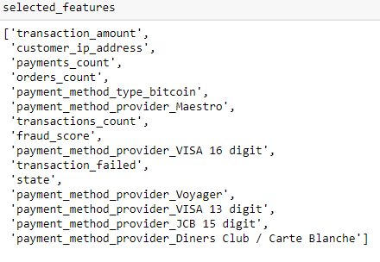
Fraud_type Model
Select the fraud data to split.
Use arbitrary value imputation missing value.
Use Random Feature importance and permutation_importance to select features.

Slide 37
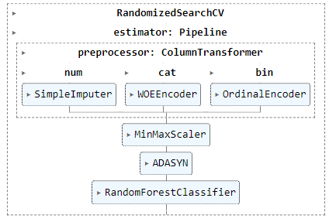
Imbalanced data
Data split: stratify=y
class_weight='balanced'
Use BorderlineSMOTE, ADASYN to address class imbalance.
ADASYN Creates new samples by interpolation of samples of the minority class and its closest neighbors. It creates more samples from samples that are harder to classify.
Borderline-SMOTE
Creates new samples by interpolation between samples of the minority class and their closest neighbors.
It does not use all observations from the minority class as templates, unlike SMOTE.
It selects those observations (from the minority) for which, most of their neighbors belong to a different class (DANGER group)
Variant 1 creates new examples, as SMOTE, between samples in the Danger group and their closest neighbors from the minority
Variant 2 creates new examples between samples in the Danger group and neighbors from minority and majority class
Try ensemble methods:
BalancedRandomForestClassifier just bagging
BalancedBaggingClassifier: bagging + resamppling
RUSBoostClassifier : boosting + resampling
EasyEnsembleClassifier: bagging + boosting + resampling

Slide 38

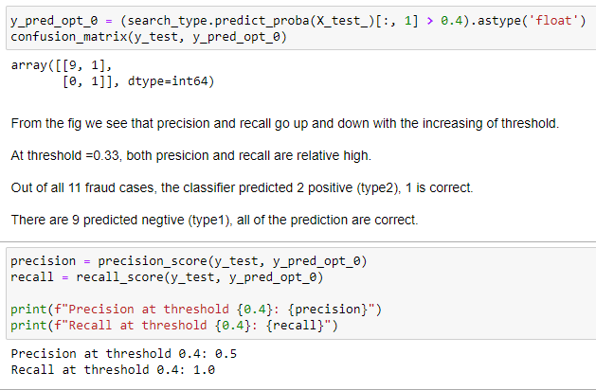

Threshold optimization

Slide 39
Summary
If there are more time, I will write a preprocessor for data clean, run SHAP to see Global/local feature importance.
If there are more time, I will be understanding more about the IP address to get the geographic location associated with the transaction, if it is matches with the customer address.
Additional data may be helpful, the Customer demographics (Age, job, housing…), Customer behavior (shopping history).

